Slide 1

WHERE DOES OUR POWER COME FROM?

Slide 2
Electricity Generation
133 TWh
Data Source
131 TWh
Real-time NYISO electricity generation data (2023–2025).
125 TWh
Analytical Scope
7 main energy sources analyzed across the state.
Methodology Note
Excludes imported power and rooftop solar generation.
2023
2024
2025

Slide 3
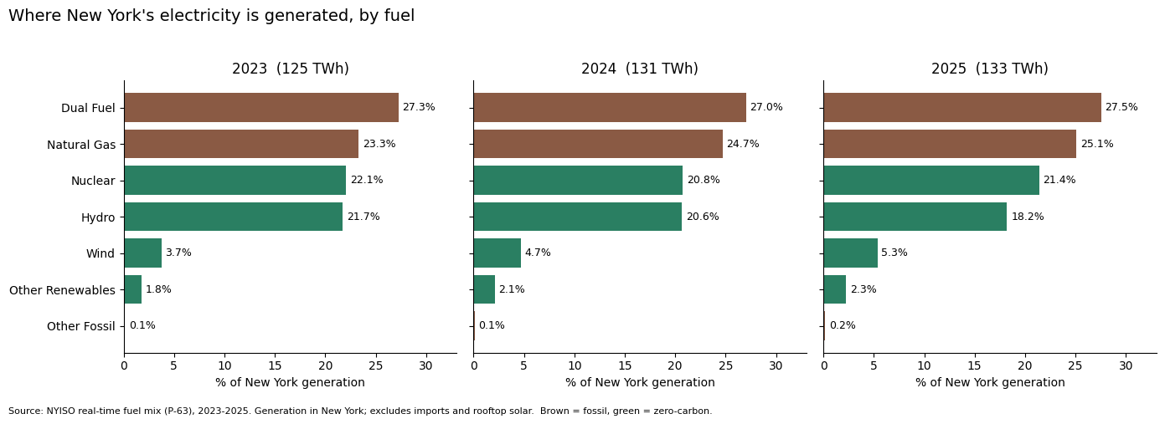
The biggest players are still fossil fuels
2025: 52.6% gas + dual fuel
Notes:
Looking at our chart, dual fuel and natural gas were the two largest sources of electricity generation. In 2025, dual fuel accounted for 27.5% and natural gas for 25.1%. Together, they represented more than half of the electricity generated in New York. And here's our first major finding: fossil fuels gained share between 2023 and 2025, even as the state pursued its clean energy goals. But that wasn't the most surprising part.

Slide 4
Evolution of Clean vs. Fossil Sources (2023–2025)
Fossil Share Expansion
Zero-Carbon Shift
Thermal generation absorbed most of the total demand growth.
Wind expansion offset by lower hydro generation output.
Dual Fuel
27.3% → 27.5%
Nuclear
22.1% → 21.4%
Natural Gas
23.3% → 25.1%
Hydroelectric
21.7% → 18.2%
Other Fossil
0.1% → 0.2%
Wind
3.7% → 5.3%
Other Renewables
1.8% → 2.3%

Slide 5

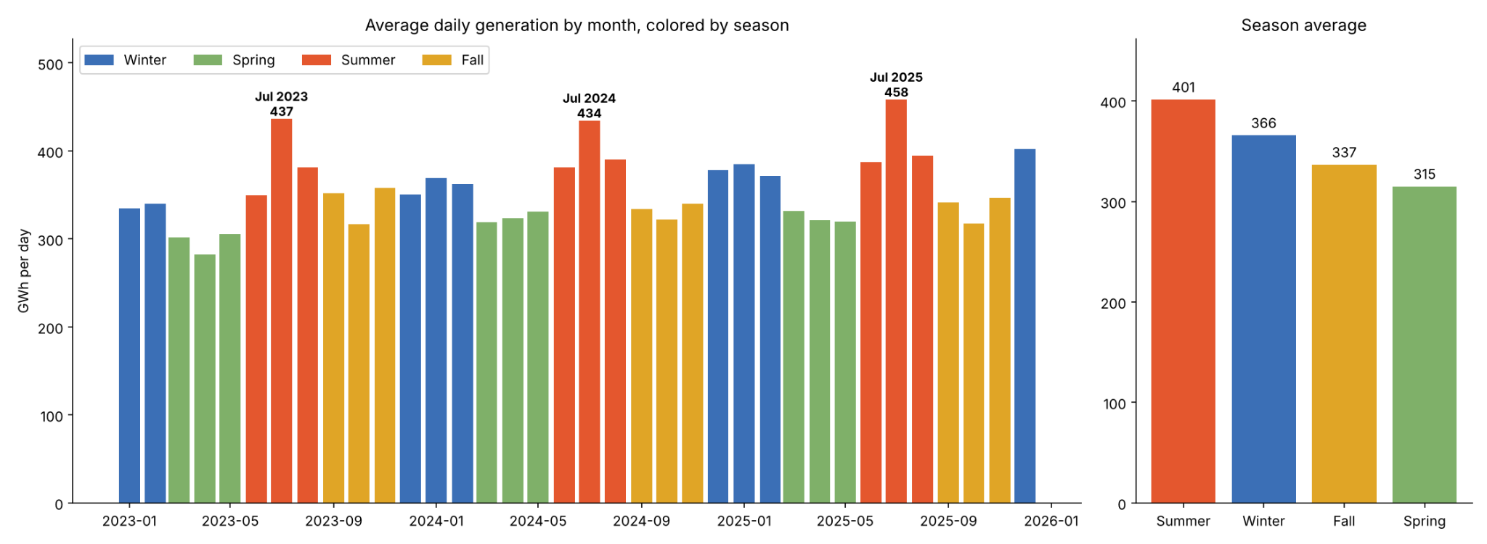
Seasonal Peaks: The Summer Challenge
All-Time Peak: July 2025
Seasonal Average
458 GWh/day driven by extensive air conditioning usage.
Summer leads at 401 GWh/day vs 315 GWh/day in Spring.

Slide 6
Bridging the Gap to 2030 & 2040 Mandates
Accelerate Offshore Wind
Energy Storage Capacity
Transmission Upgrades
Needs faster scaling to overcome climate-driven decreases in hydroelectric output.
Essential to flatten the 458 GWh summer daily peak demand without relying on natural gas.
Transmission bottlenecks must be unlocked to deliver clean power directly into NYC.

